Slide 1
Enterprise Mobility Showcase
22-Oct-2019
Partha Datta
Piyush Goswami

Slide 2
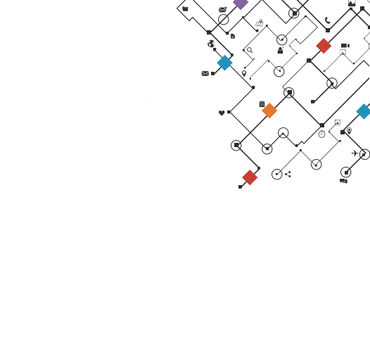
Agenda
Mobility Strategy
Glimpse of apps available
Demo Apps

Slide 3


Enterprise Mobile Engineering (EME) Strategies
App Upgrade
Aunthen- tication
GTM
Develop Solutions Together
CI/CD
Single Entry-Exit Point for all Mobile Solutions
Analytics
Legal
Push Notification
Mobile Buss. Enablement
Mobility Solution Development
Platforms
Branding
Mobility Offering & Enablement
Secure Browser Container
Prebuilt Security/Performance Evaluated Mobility Solutions from EME
Self-Service Portal*
Mobility Standards
Mobility Governance & Support
Security
Platforms
Hosting
Provide Consultation
Remote Config.
Native
End-to-End Mobility Solution
App Signing
Dell - Internal Use - Confidential

Slide 4



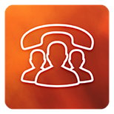















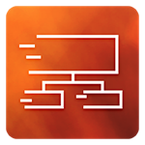










Dell Mobile Application Portfolio
Production Applications Driving High-Value Business Interactions
Team Member Productivity
Sales & Prospect Enablement
Practitioner Engagement
Executive Portfolio
EZ Dialer
VxRail To Go
Tableau Enterprise
GRC Reports
Events
myQuote Approvals
Dell EMC Mobile
Help-A-Customer
Engage
GeM Tracker
Partner News
vApprove
Spaces
Tricorder
Burn Notification
Sales Dashboard
EZ OrgChart
My Sales
My Orders
APJ Dashboard
Help
EMC BI
Tableau Big Data
DSC Supplier Profile
My Guest
E-Lab Navigator
Hack Platform

Slide 5



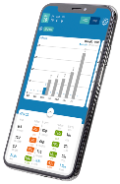
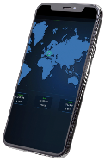
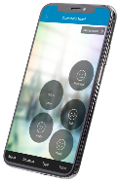
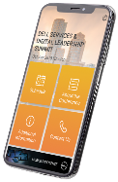




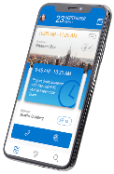
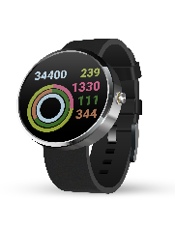
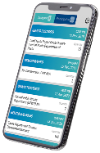
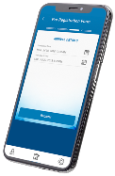



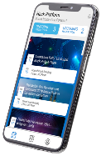
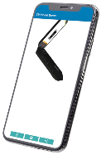
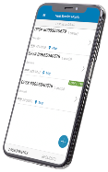
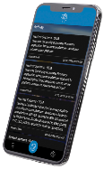
Demo Apps
1
2
3
4
GRC Reports
Sales Dashboard
Help A Customer
Events
Empowering All Dell mobile application for the executives to view the weekly/quarterly forecast along with current revenue, margin details with drill down functionality for world-wide leadership team
It shows the real time sales and revenue information across globe
Empowering All Dell Team Members to Engage as Customer Advocates
This app enables the user to check the details and schedules of an oncoming registered event
5
6
7
8
Engage
Burn Notification
GeM Tracker
My Guest
Connect to your meetings, calendar and colleagues, all in one easy to use place. Find content from Dell’s web properties.
Android Mobile and smart watch app which will be used to check/monitor the software burn status within Dell factory. It is an intelligent Information systems for Storage ET operators
A mobile application for the business partner (India Sales Teams) to assign and track the bids for the Government e Marketplace tenders
An innovative All-Ireland solution for registering visitors to visit our buildings.
Hack
9
3D Viewer
10
E-Lab Navigator
11
12
Tricorder
Hack platform is an application which provides the podium to host hackathon, vote for your favourite team, submit ideas, submit problem statements.
A 3D Model Viewer application is developed to showcase 3D rendering of laptop based on the image detected by phone camera. User can able to rotate & check all
Easy Customer and Partner Access to View, Save & Share e-Lab Certified Configurations
Simplifying the Solution Selling Process for Sales Teams Engaging with Customers & Prospects

